Slide 1
Sets
CS 236
Fall 2023

Slide 2
Overview and Due
Set definitions
Monday not flipped class. Wednesday is the next flipped class
Due
HW 0 due today
HW 1 due Monday
Project 0 due Wednesday
Project 1 due Thursday, Sept 28
We’ll have discussed all required material by Monday, Sept 18
Please start early

Slide 3
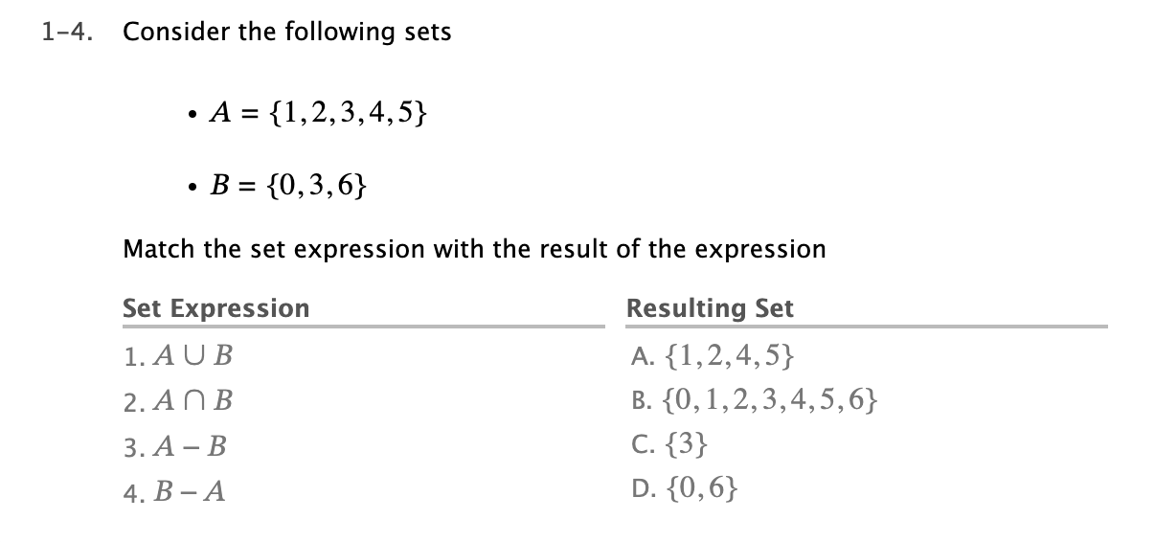
or
Everything in either A or B

Slide 4

and
Everything in both A and B

Slide 5
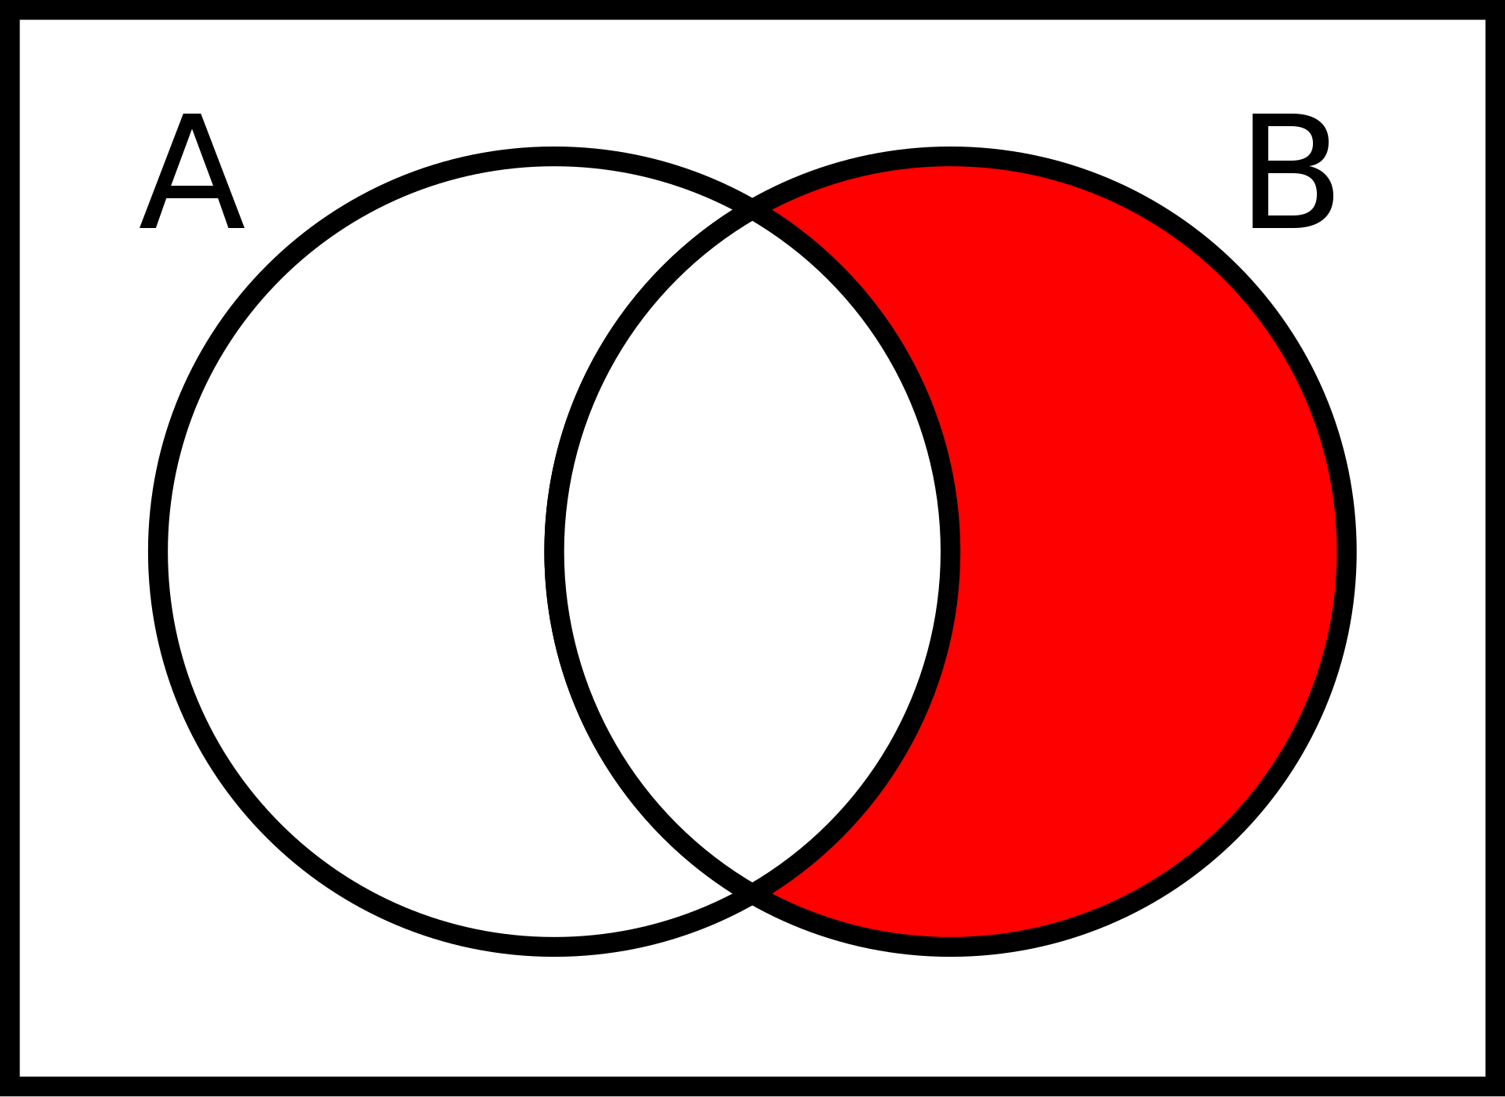
Everything in B that is not in A
Image from https://commons.wikimedia.org/wiki/File:Relative_compliment.svg#/media/File:Relative_compliment.svg

Slide 6
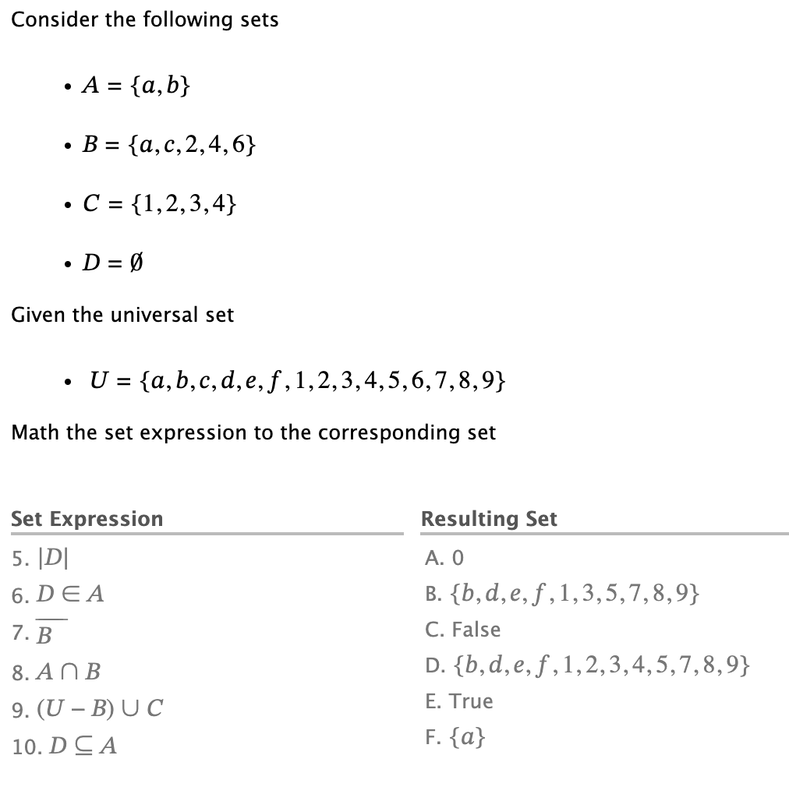


Everything in U that is not in B
Images from https://en.wikipedia.org/wiki/Complement_(set_theory)

Slide 7




if … then …
If it’s in A then it is also in B
Images from https://en.wikipedia.org/wiki/Complement_(set_theory)

Slide 8
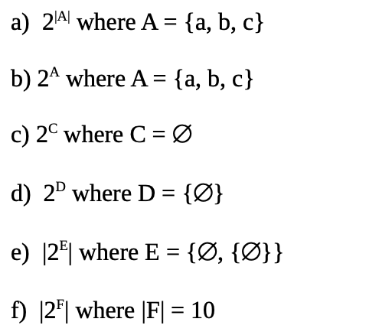
Evaluate the following
Power set notation
Set cardinality
How many elements in
, which is the empty set
, which is a set containing the empty set
What is the answer to part d if
What is the answer to part 3 if

Slide 9
A Few Clarifications from the Reading: Power Set Visualization
Set builder notation allows us to describe what elements are in a set without listing them
Set A

Slide 10



A Few Clarifications from the Reading: Power Set Visualization
Set builder notation allows us to describe what elements are in a set without listing them
Element of
Subset of
∈ A
{. }⊆ A
Set A = { , , }

Slide 11
A Few Clarifications from the Reading: Power Set Visualization
Set builder notation allows us to describe what elements are in a set without listing them
Power set is a set of sets
Set A = { , , }

Slide 12
A Few Clarifications from the Reading: Power Set Visualization
Set builder notation allows us to describe what elements are in a set without listing them
Power set is a set of sets
Always contains the empty set
Set A = { , , }

Slide 13
A Few Clarifications from the Reading: Power Set Visualization
Set builder notation allows us to describe what elements are in a set without listing them
Power set is a set of sets
Always contains the sets containing individual elements
Set A = { , , }

Slide 14
A Few Clarifications from the Reading: Power Set Visualization
Set builder notation allows us to describe what elements are in a set without listing them
Power set is a set of sets
Always contains the sets containing individual elements
Set A = { , , }

Slide 15
A Few Clarifications from the Reading: Power Set Visualization
Set builder notation allows us to describe what elements are in a set without listing them
Power set is a set of sets
Always contains the sets containing individual elements
Set A = { , , }

Slide 16
A Few Clarifications from the Reading: Power Set Visualization
Set builder notation allows us to describe what elements are in a set without listing them
Power set is a set of sets
Always contains the sets containing individual elements
Set A = { , , }

Slide 17
A Few Clarifications from the Reading: Power Set Visualization
Set builder notation allows us to describe what elements are in a set without listing them
Power set is a set of sets
Always contains the sets containing pairs of elements
and so on
Set A = { , , }

Slide 18
A Few Clarifications from the Reading: Power Set Visualization
Set builder notation allows us to describe what elements are in a set without listing them
Notes:
\mathcal{P}(A) = \{ \emptyset, \{\ \ \ \ \}, \{\ \ \ \ \},\\
\hspace*{1.5in} \{\ \ \ \ \},\ldots\}

Slide 19
A Few Clarifications from the Reading: Power Set Visualization
Set builder notation allows us to describe what elements are in a set without listing them
Notes:
\mathcal{P}(A) = \{ \emptyset, \{\ \ \ \ \}, \{\ \ \ \ \},\\
\hspace*{1.5in} \{\ \ \ \ \},\ldots\}

Slide 20
A Few Clarifications from the Reading: Power Set Visualization
Set builder notation allows us to describe what elements are in a set without listing them
Power set is a set of sets
Notes:
\mathcal{P}(A) = \{ \emptyset, \{\ \ \ \ \}, \{\ \ \ \ \},\\
\hspace*{1.5in} \{\ \ \ \ \},\ldots\}

Slide 21
A Few Clarifications from the Reading: Power Set Visualization
Set builder notation allows us to describe what elements are in a set without listing them
Power set is a set of sets
Always contains the empty set
Notes:
\mathcal{P}(A) = \{ \emptyset, \{\ \ \ \ \}, \{\ \ \ \ \},\\
\hspace*{1.5in} \{\ \ \ \ \},\ldots\}

Slide 22
A Few Clarifications from the Reading: Power Set Visualization
Set builder notation allows us to describe what elements are in a set without listing them
Power set is a set of sets
Always contains the sets containing individual elements
Notes:
\mathcal{P}(A) = \{ \emptyset, \{\ \ \ \ \}, \{\ \ \ \ \},\\
\hspace*{1.5in} \{\ \ \ \ \},\ldots\}

Slide 23
A Few Clarifications from the Reading: Power Set Visualization
Set builder notation allows us to describe what elements are in a set without listing them
Power set is a set of sets
Always contains the sets containing pairs of elements
Notes:
\mathcal{P}(A) = \{ \emptyset, \{\ \ \ \ \}, \{\ \ \ \ \},\\
\hspace*{1.5in} \{\ \ \ \ \},\ldots\}

Slide 24
A Few Clarifications from the Reading: Power Set Visualization
Set builder notation allows us to describe what elements are in a set without listing them
Power set is a set of sets
Always contains the sets containing pairs of elements
Notes:
\mathcal{P}(A) = \{ \emptyset, \{\ \ \ \ \}, \{\ \ \ \ \},\\
\hspace*{1.5in} \{\ \ \ \ \},\ldots\}

Slide 25
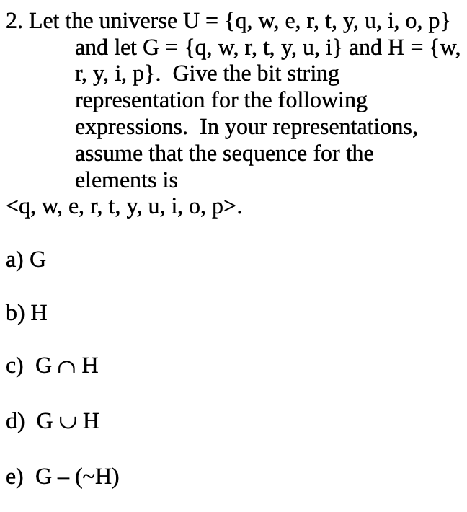
Universe = set of all possible elements of any set
Bit string representation of set
Order the elements of the universe
U = ['q','w','e','r','t’,’y’,'u','i','o','p’]
A = {'r','p'}
bitString_A = [1 if x in A else 0 for x in U]
U = ['q','w','e','r','t’,’y’,'u','i','o','p’]
bitString_A = [ 0, 0, 0, 1, 0, 0, 0, 0, 0, 1]
ChatGPT prompt
what does the following Python code do
bitString_A = [1 if x in A else 0 for x in U]

Slide 26
The set of all things
“such that”
the “things” satisfy this property

Slide 27
Cartesian Product
The set of all ordered triples whose
first element is from A
second element is from B
third element is from C
for a in A:
for b in B:
for c in C:
A_cross_B_cross_C.add(tuple([a,b,c]))
The set of all ordered pairs whose
first element is from A
second element is from B
for a in A:
for b in B:
A_cross_B.add(tuple([a,b]))

